Slide 1

Dietitian Website Management System
Gorkem Ozyurt
218MI1034

Slide 2

What is Dietitian website?
dietitian website; It is a website where customers find healthy food and beverage recipes and buy necessary supplements, as well as get support from a dietitian online. It .

Slide 3
Aim of Dietitian website
The main aim of a dietitian website is to provide information and resources to the general public, patients, and clients on healthy eating, nutrition, and lifestyle management. This includes providing information on the services offered by the dietitian, such as consultation, assessment, nutrition education, and therapy. A dietitian website can also serve as a platform for the dietitian to establish a professional online presence and to communicate with their clients and patients.

Slide 4
Benefits of dıetıtıan websıte Management System
Increased revenue by reaching more clients and providing online consultations and meal plans.
Increased visibility and credibility of your practice through an easy-to-use website that can be accessed by clients, referrals, and other healthcare providers.
Cost savings through reduced administrative tasks and improved client retention.
Dietitians can access client's data and history in a timely manner.

Slide 5
TECHNOLOGIES USED AND THEIR DEFINITIONS
C#
.Net Freamwork
Entity Freamwork
Code first

Slide 6
DESIGN PATTERNS TO BE USED IN THE PROJECT
MVC

Slide 7
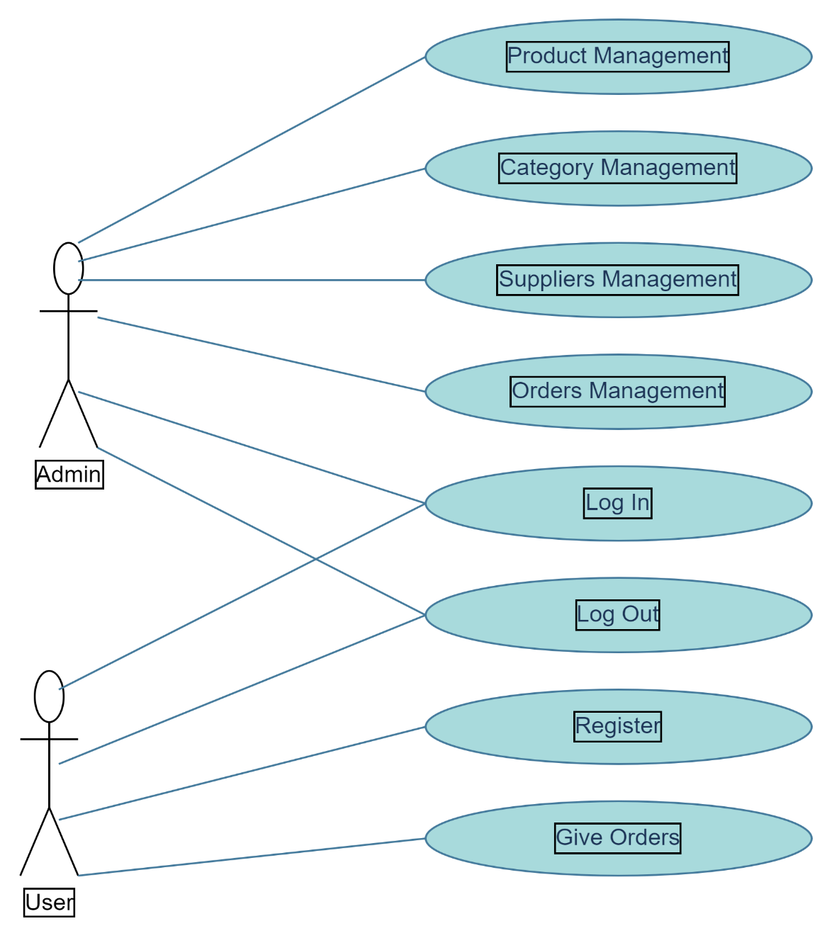
Use case dıagram

Slide 8
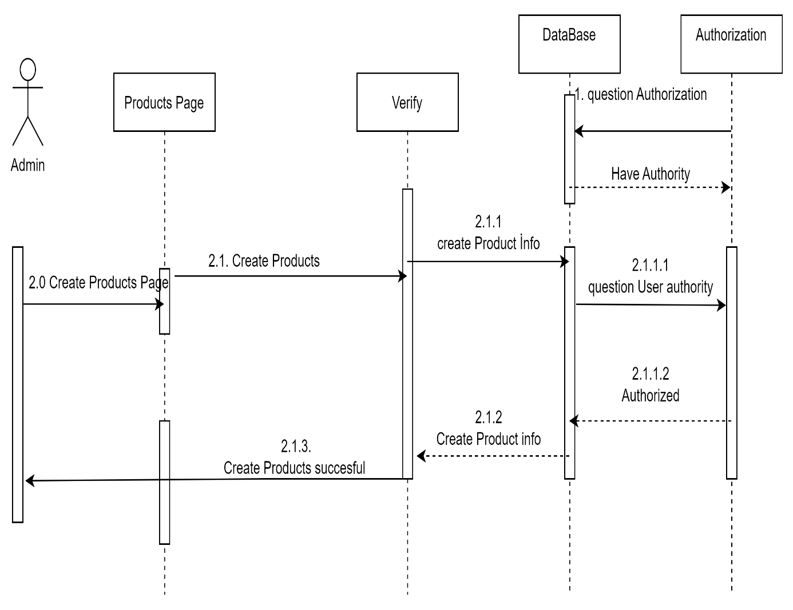
some sequence dıagrams for Scenarios

Slide 9


Slide 10
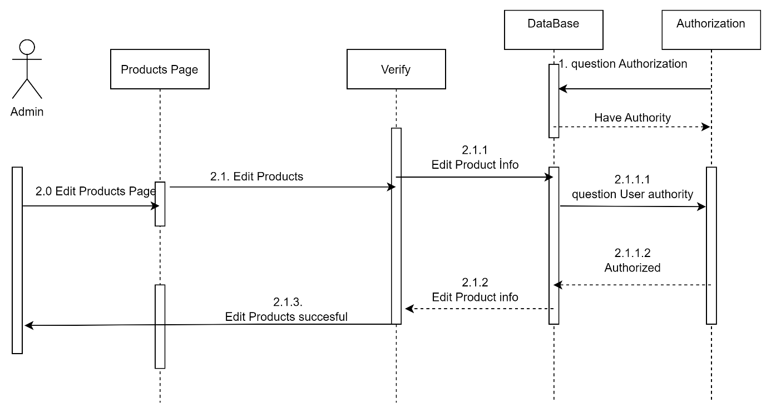

Slide 11

Now, I Want to Show my Project via mıcrosoft vısual studıo…

